Slide 1
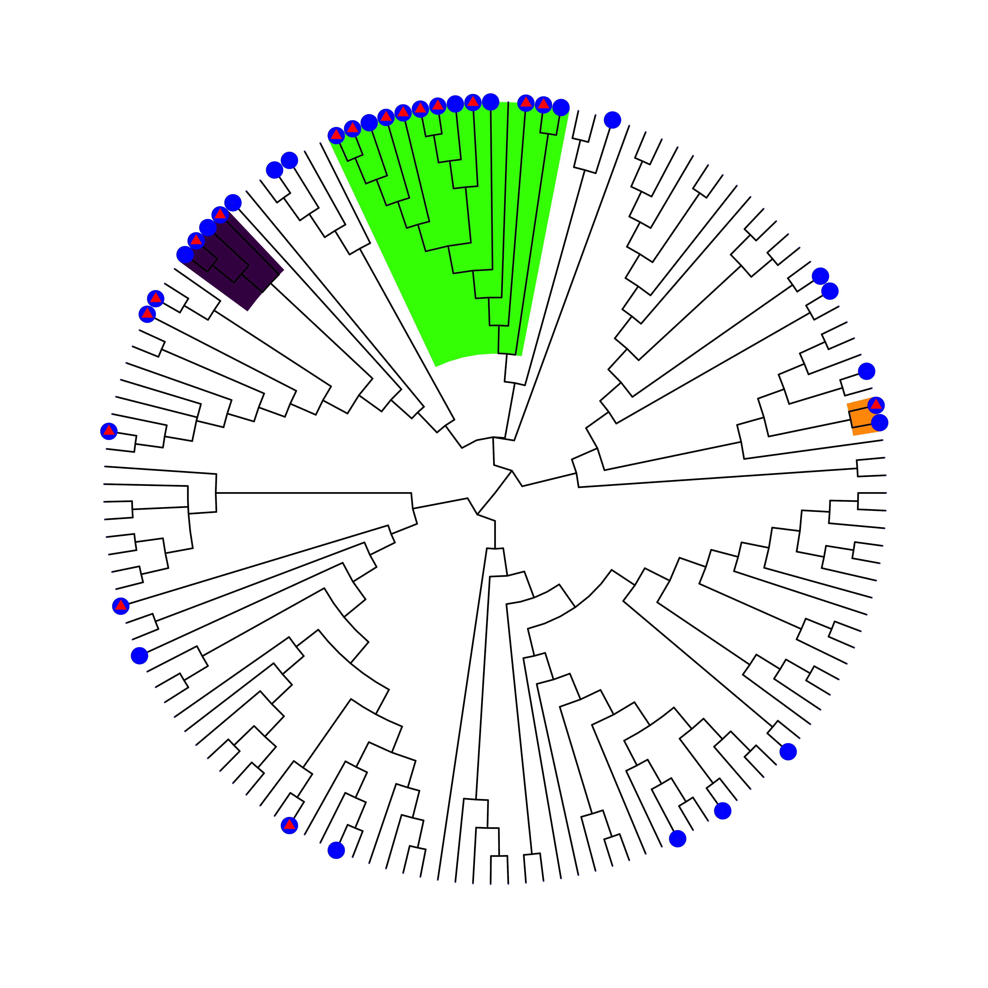
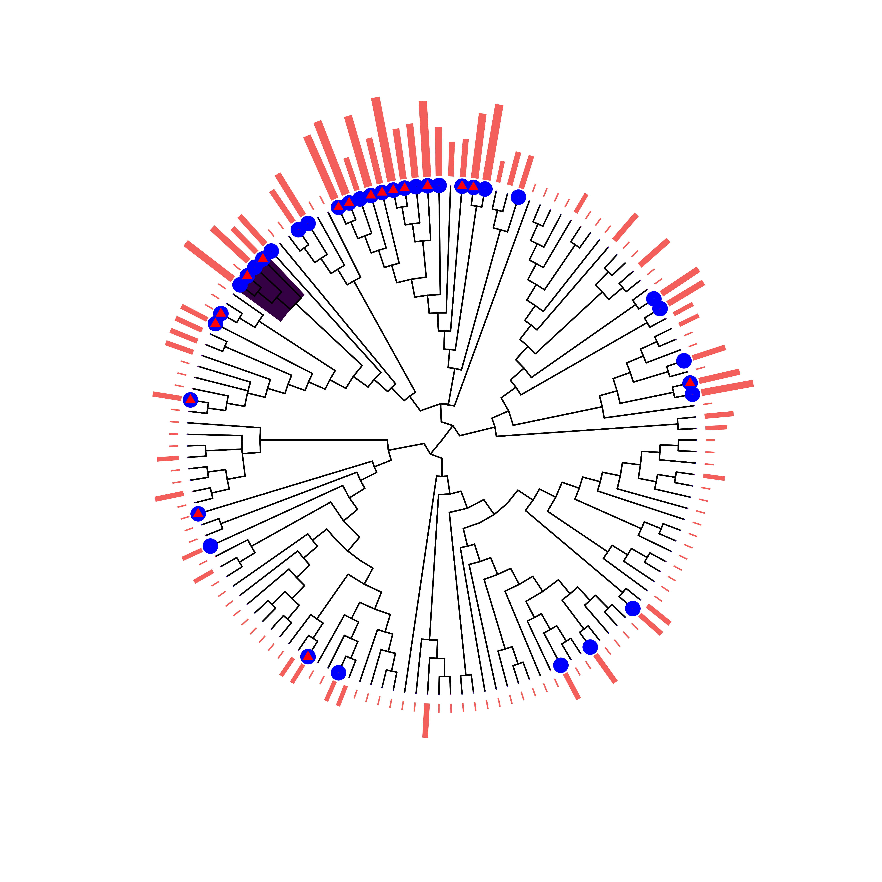
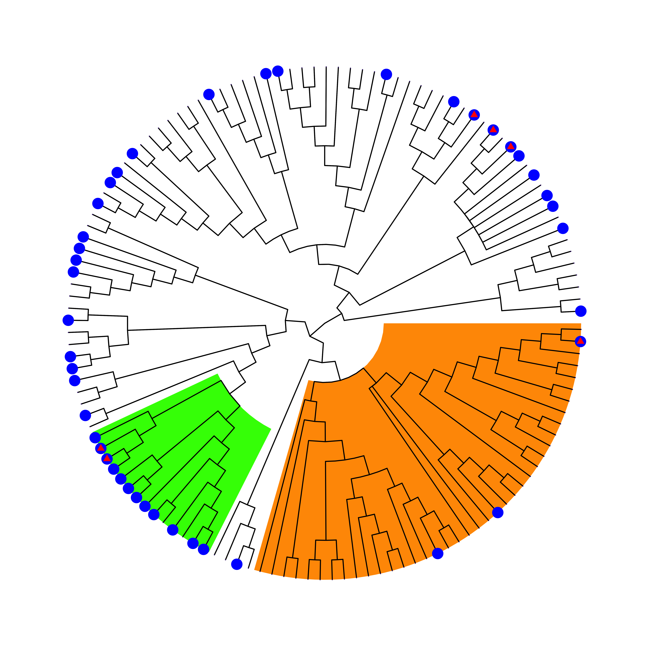
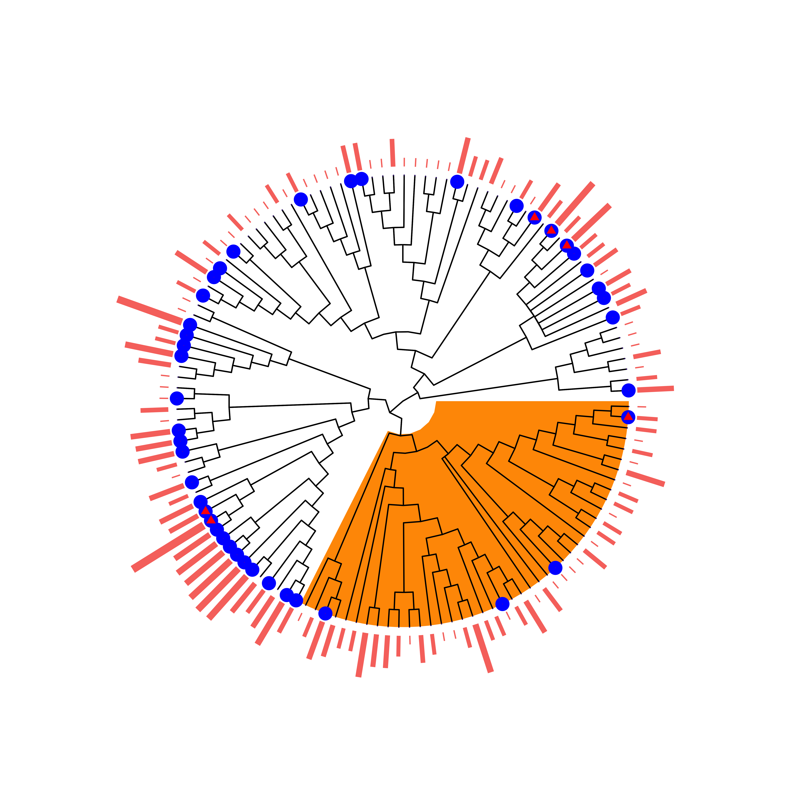

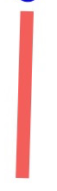
Ignoring Sampling Effort
Controlling for Sampling Effort
A
B
Henipavirus
Factor # | Name | Tax. Level | Species | % Species Positive | LOS
1 | Pteropodinae | Subfamily | 14 | 93 | < 0.01
2 | Rousettus | Genus | 4 | 100 | < 0.01
3 | Hipposideros | Genus | 2 | 100 | 0.058
- | Paraphyletic Remainder | - | 119 | 14 | -
Factor # | Name | Tax. Level | Species | % Species Positive | LOS
1 | Rousettus | Genus | 4 | 1 | .23
 | Paraphyletic Remainder |  | 135 | 0.237 | -
C
D
Filovirus
Key
Factor # | Name | Tax. Level | Species | % Species Positive | LOS
1 | Pteropodidae | Family | 14 | 86 | < 0.01
2 | Rhinolophoidea | Superfamily | 39 | 8 | < 0.01
- | Paraphyletic Remainder | - | 79 | 35 | -
Factor # | Name | Tax. Level | Species | % Species Positive | LOS
1 | Rhinolophoidea | Superfamily | 43 | 9.3 | 0.004
- | Paraphyletic Remainder | - | 89 | 43.8 | -
AB +
PCR +
1+ ln(Sampling Effort)

Slide 3
How does the algorithm work?
Creates a basis vector
Maximizes an objective function using this basis vector
Continues to try all basis vectors
Returns basis vector with maximum objective function

Slide 4
Two issues
Number of clades to select
Dealing with missing data

Slide 5
Can penalized LS help?
Could help in selecting number of clades
TBD
Could also help with missing data, penalizing selecting clades where majority of data is missing

Slide 6
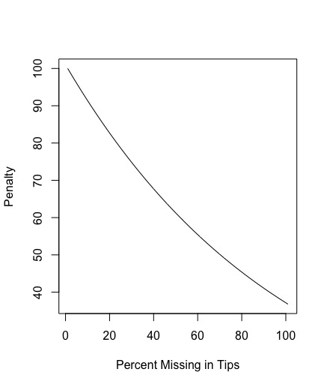
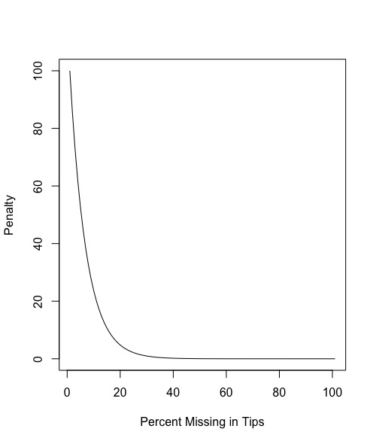
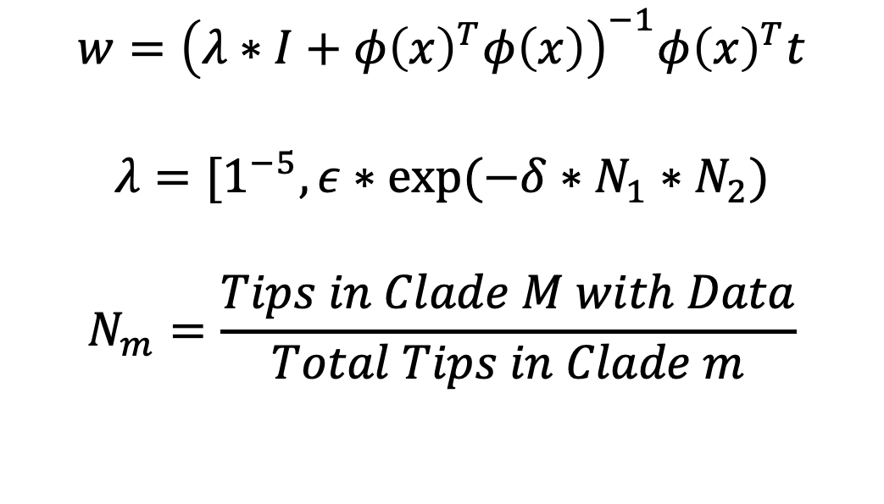
How should we penalize missing data?
$$w={\left(λ∗I+φ{\left(x\right)}^{T}φ\left(x\right)\right)}^{−1}φ{\left(x\right)}^{T}t$$
$$λ=[1^{−5}, ε∗exp⁡(−δ∗N_{1}∗N_{2})$$
$$N_{m}=\frac{Tips in Clade M with Data}{Total Tips in Clade m}$$
Delta = 1
Delta = 16

Slide 8
Process
Generate a tree with some data
Split the tree into training and testing
Find optimal penalty term

Slide 9
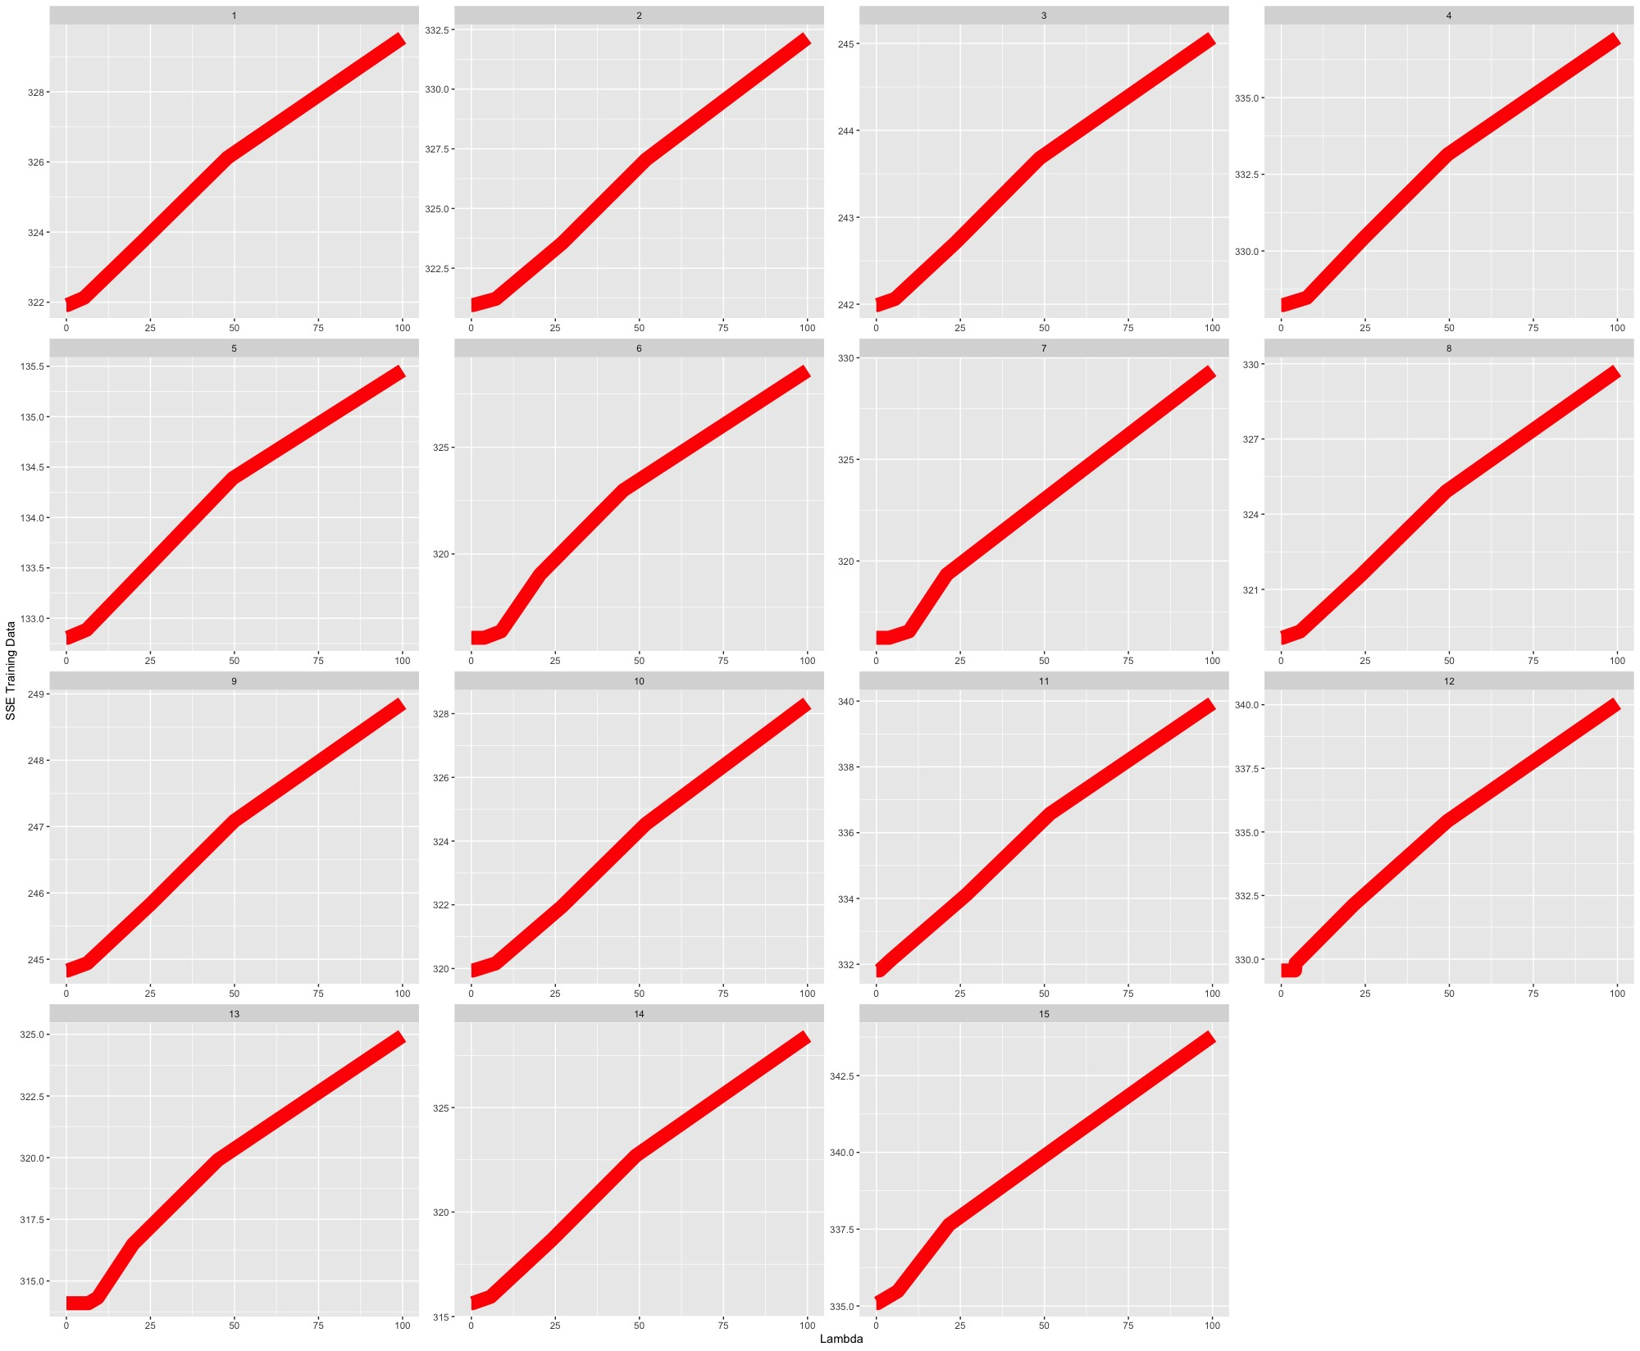
As lambda gets larger, SSE of training data increases
X axis: lambda
Y axis: SSE errors on the training data
Each square is a different testing and training split

Slide 10
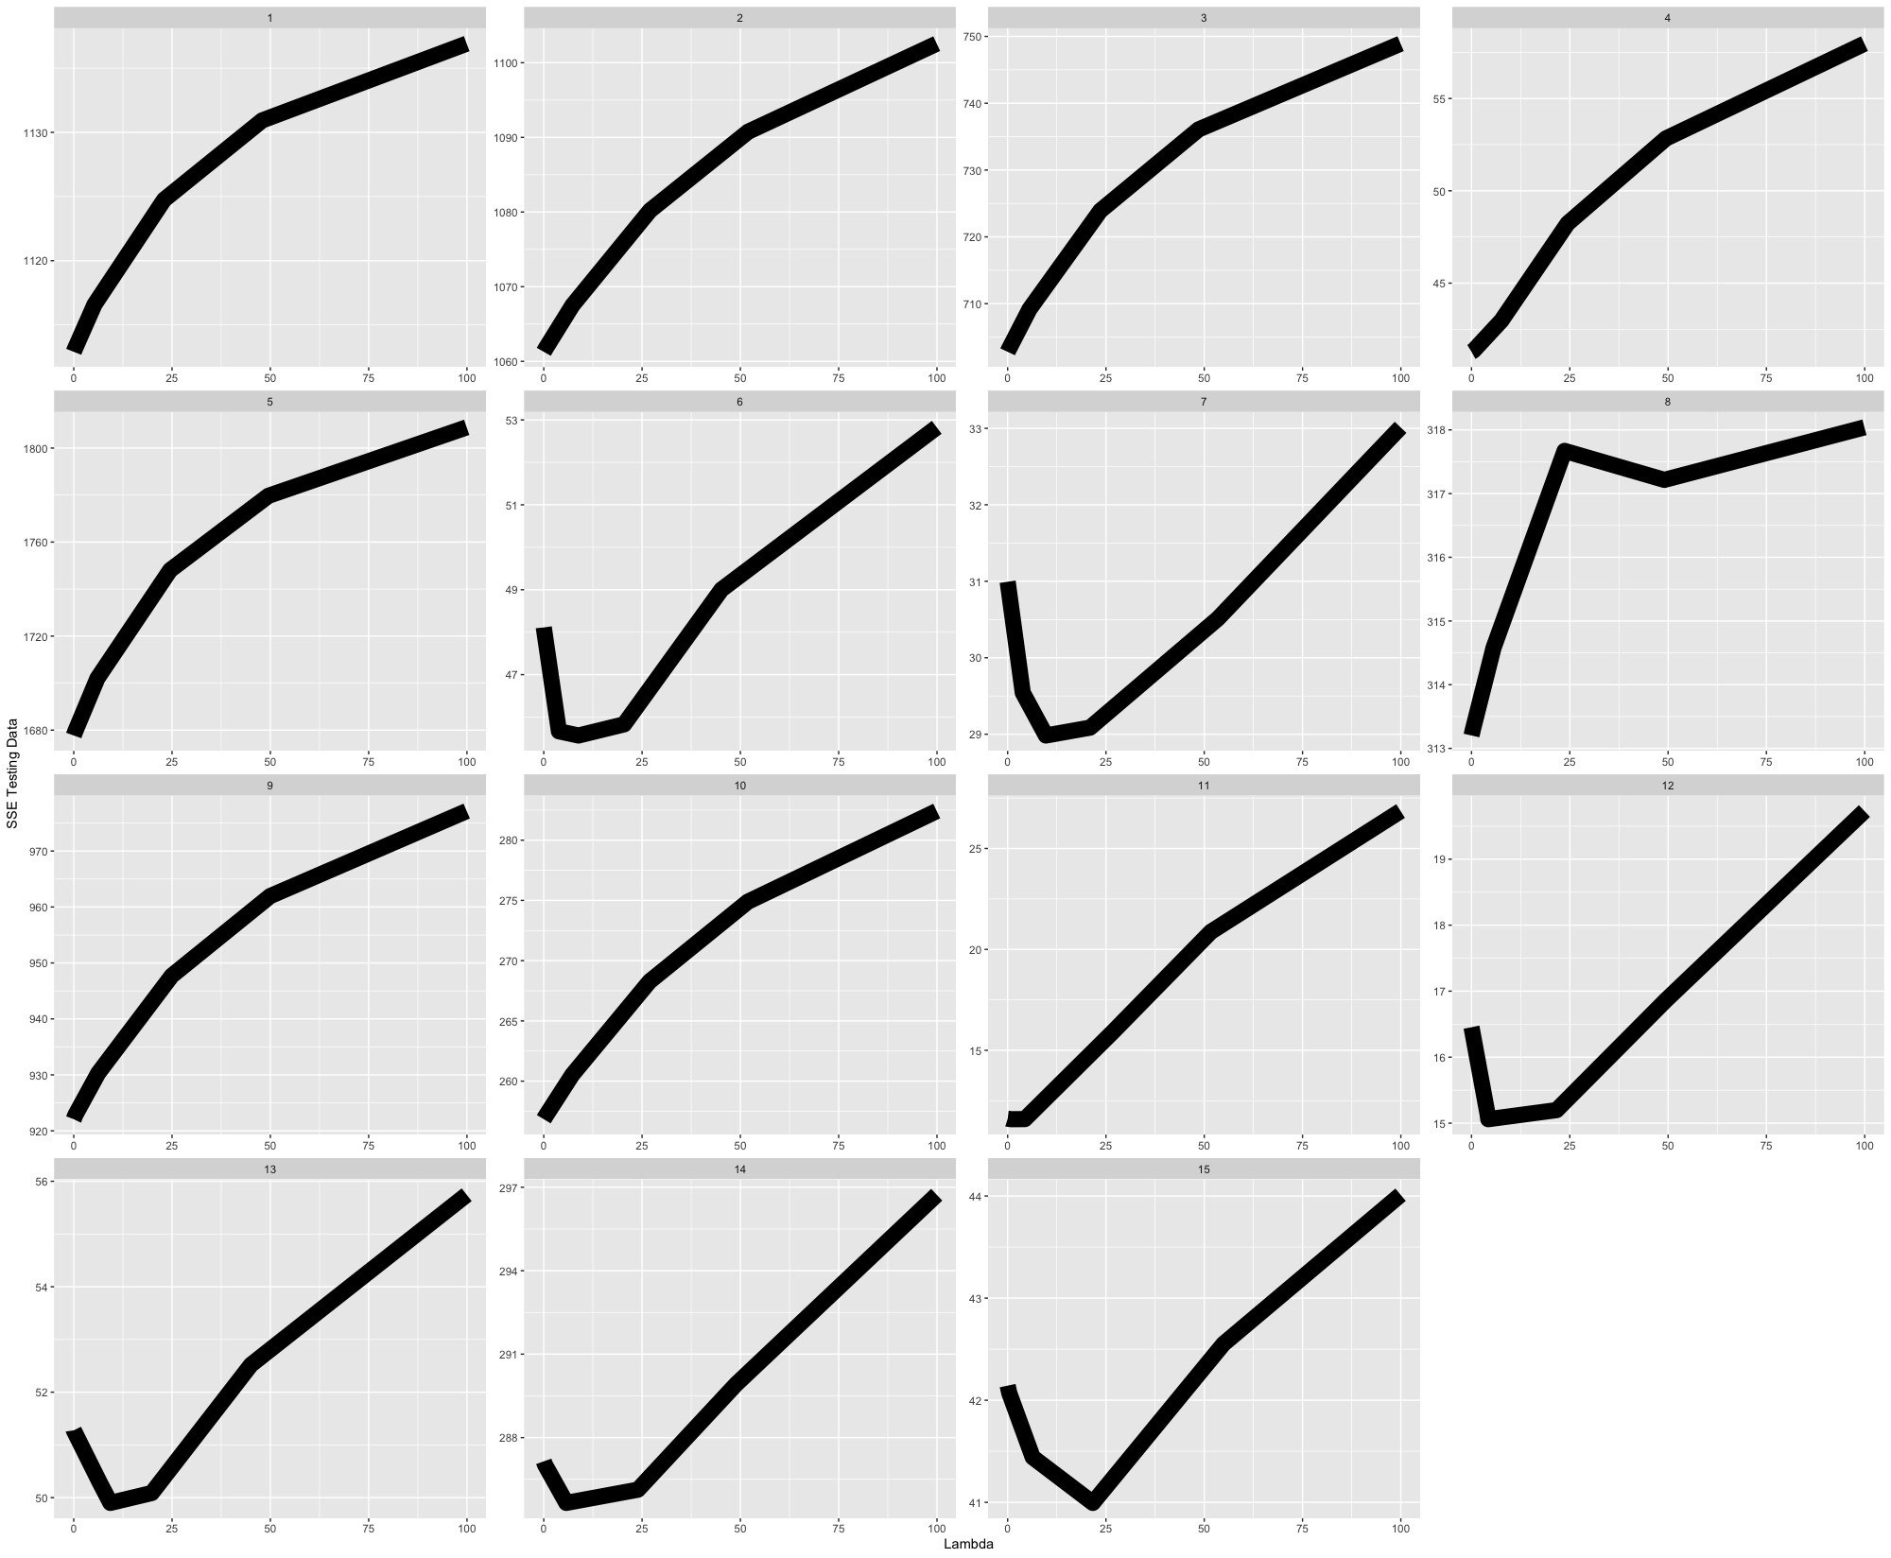
As lambda gets larger, SSE of testing data …is unique
X axis: lambda
Y axis: SSE errors on the testing data
Each square is a testing an training split

Slide 11
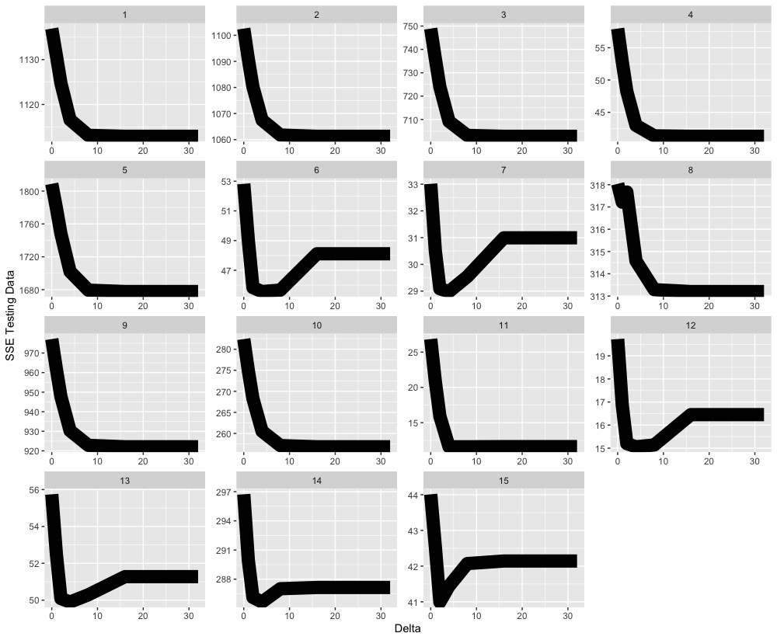
Comparing lambda and delta
X axis: lambda
Y axis: SSE errors on the testing data
Each square is a testing an training split
X axis: delta
Y axis: SSE errors on the testing data
Each square is a testing an training split
Notes:
Simulation 1:
Sometimes we are choosing the correct edge to split, and the penalty term is hurting us
Sometimes, we can improve our selection by imposing the penalty.
We are missing around 20% of our data here

Slide 12
Conclusions
The testing error does seem be an improvement over previous methods, especially in cases with missing tip information
The bigger improvements will come once we can choose more than one clade

